Slide 1
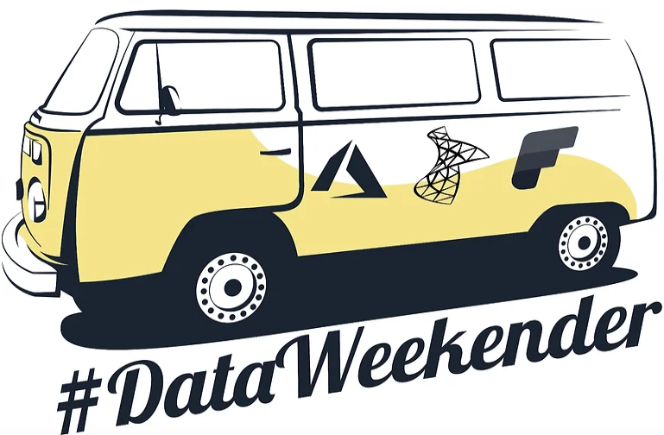

Utilizing Microsoft Fabric for Metadata-Driven Pipelines

Slide 2
The purpose of this session is to introduce you to the concept of metadata-driven pipelines that you can leverage within your domain and for your data using Azure Data Factory, Azure Synapse Analytics data integration pipeline, or Microsoft Fabric. We will explore one of the approaches out of many available. Today, we won't be discussing ETL or Medallion architecture.

Slide 3







Alpa Buddhabhatti
She/Her
Azure Data Engineer/Trainer
Microsoft Certified Trainer(MCT)
Azure Developer(AZ-204)
Azure Data Engineer(DP-203)
Azure Data Scientist(DP-100)
Azure Administrator(AZ-104)
alpabuddhabhatti
@AlpaB7
alpaBuddhabhatti/MetadataDrivenPipeine
@meetalpa
@alpabuddhabhatti
https://maven.com/alpa-buddhabhatti/adft

Slide 4
Agenda
Quick Overview of Microsoft Fabric
Overview of a Metadata-Driven Pipeline
Demo
Conclusion
Q&A

Slide 5
Abstract
During this session, we will explore the concept of metadata-driven Azure data pipelines within the framework of Microsoft's Azure Data Factory, focusing on the utilization of Microsoft Fabric to efficiently process various data sources. This demonstration will showcase the seamless integration of the following services: **Microsoft Fabric **Azure SQL By the end of this session, attendees will acquire valuable insights into Microsoft Fabric and gain inspiration on how to leverage its capabilities within their respective business domains.

Slide 6
1.Microsoft Fabric Quick Overview

Slide 7











Microsoft FABRIC
A comprehensive solution that meets all your data integration, engineering, real-time analytics, data science, and BI
Data
Factory
Synapse Data
Engineering
Synapse Data
Science
Synapse Data Warehousing
Synapse Real Time Analytics
Power BI
Data Activator
Serverless
Compute
T-SQL
Spark
Event
Streams
Pipelines
Data
Activator
KQL
Distributed compute system with isolation boundary, unparalleled speed and efficiency
OneLake Storage
OneSecurity
Finance
CRM
HR
MDM
Operational
Analytics
Single, unified, logical data lake for the whole organization, simplifying data management and collaboration
Shortcuts
Shortcuts enable easy data sharing, eliminating the data duplication and simplifying data collaboration
Azure
Amazon
Google

Slide 8

2. Overview of a Metadata-Driven Pipeline

Slide 9
Metadata Driven Approach – What?
Data about data OR the structure of business output
It answers :
What information is contained in the business outcome or data?
1.Source and Sink data source (e.g. SFTP, Blob, OneLake, etc)
2. Data sources Types (e.g. file, table)
What processes were applied to the data related to your business outcome or data?
1. Operations like
- Delta loads (only loading changes)
- Full loads (loading all data)
- Deletes, Updates, and any other data transformation
2. Email Functionality
How is the data processed and transformed?
Where data store after each steps during ETL or ELT. (e.g Data storage location or system)
Config information regarding a specific Business output or requirement

Slide 10
Metadata Driven Approach – When?
Incremental Load and transformation
Dealta Load and transformation
Based on operation - Executing store procedure, update table, delete data
How to load multiple tables ,files, APIs, etc using a single or few pipeline
Metadata-driven approaches provide a way to define, manage, and automate these processes, making data integration and transformation more flexible and efficient

Slide 11
Metadata Driven Approach – Why?
Easy to Maintain
Ready for future Features
Acceleration/ Quick development cycle
Reduces Mistakes
Uniformity
Scalability
Auto Documents

Slide 12
Metadata Driven Approach – HOW?
Purpose to Injecting data using :
Microsoft Fabric Azure Data Factory
Azure SQL Database (or Fabric Warehouse)
Azure Blob Storage (or Fabric Lakehouse)

Slide 13
Business Requirements

Slide 14
Metadata Driven Approach – BO1?
BO1 :
100 tables
Tables saved as .csv to SFTP
Full Load for tables
Load only selected columns
Different target locations
Delete operation based on filter conditions (for 20 tables)
Should be scalable with minimal code/config
No email functionality

Slide 15
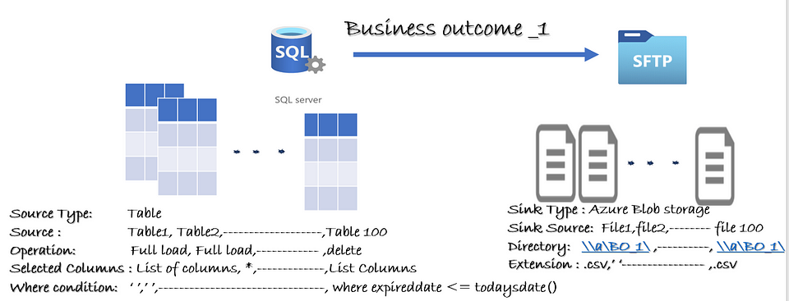
Metadata Driven Approach – BO1

Slide 16
Metadata Driven Approach – BO2
BO2 :
100 tables
Tables saved as .csv to Blob Storage
Full Load for tables
Tables saved as .csv files
No Email Functionality

Slide 17
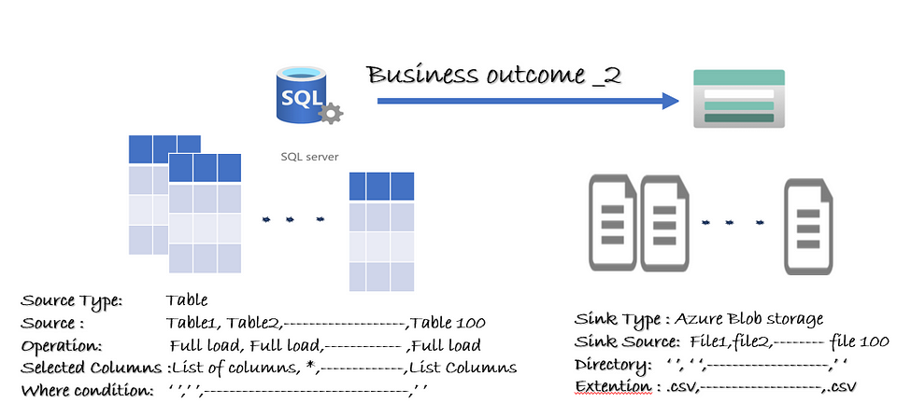
Metadata Driven Approach : BO2

Slide 18
Metadata Driven Approach – BO3
BO3 :
20 Files in Azure Blob Storage
Create SQL table for each file
Load only selected columns
Email Functionality for Delta Load

Slide 19
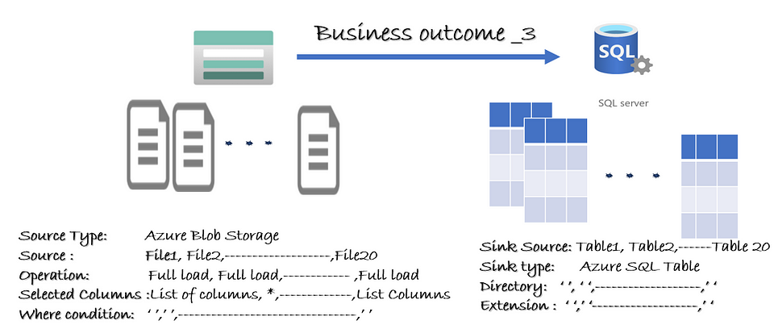
Metadata Driven Approach : BO3

Slide 20



Data Injections
Azure Blob Storage
Data Movements
Batch Job
Config/ Control tables
Staging/Row Data Tables
Azure SQL Database

Slide 21
Useful Resources Links
Environment Set UP:
Create your own Microsoft Fabric environment - Kevin Chant (kevinrchant.com)
A Beginner’s Guide to Microsoft Fabric | by alpa buddhabhatti | Sep, 2023 | Medium
Microsoft Fabric
Get started with Microsoft Fabric - Training | Microsoft Learn
Metadata Driven Pipeline in Fabric
Step-by-Step Guide for Building Metadata Driven Pipelines in Microsoft Fabric - Microsoft Community Hub

Slide 22
DEMO Resources
GitHub Code Repo:
alpaBuddhabhatti/MetadataDrivenPipeine (github.com)
Blog:
alpa buddhabhatti – Medium

Slide 23
Conclusion
Microsoft Fabric
- A unified software-as-a-service (SaaS)
- OneLake like onedrive
- One platform, one system, one product, one experience, one architect, one Business Model and one united space where data experts and business teams can work together on data
Metadata Driven pipeline
- same your time & cost
- Scalability
- Reusability
- Unified code

Slide 24
Alpa Buddhabhatti
Thank you!!
She/Her
Azure Data Engineer/Trainer
Microsoft Certified Trainer(MCT)
Azure Developer(AZ-204)
Azure Data Engineer(DP-203)
Azure Data Scientist(DP-100)
Azure Administrator(AZ-104)
alpabuddhabhatti
@AlpaB7
alpaBuddhabhatti/MetadataDrivenPipeine
@meetalpa
@alpabuddhabhatti
https://maven.com/alpa-buddhabhatti/adft

Slide 25
Alpa Buddhabhatti
Q & A
She/Her
Azure Data Engineer/Trainer
Microsoft Certified Trainer(MCT)
Azure Developer(AZ-204)
Azure Data Engineer(DP-203)
Azure Data Scientist(DP-100)
Azure Administrator(AZ-104)
alpabuddhabhatti
@AlpaB7
alpaBuddhabhatti/MetadataDrivenPipeine
@meetalpa
@alpabuddhabhatti
https://maven.com/alpa-buddhabhatti/adft

Slide 26

Metadata Driven Approach : BO4
- DELTA Load
- Email Functionality
- bo4-in
- URL
Source Data Source
Sink Data Source
Azure Blob Storage
What should I do to make it work? Should I create a new pipeline? Which tables need to be changed?

Slide 27



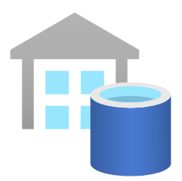
Metadata Driven Approach – BO5
Bronze
RAW
Silver
ODS
Gold
Reporting
Batch Job
Config/ Control tables
Azure SQL Server

